Slide 1
Fast Weighted Median Filtering
Team Mob_Psycho
Kanav Gupta
Anurag Mehta
TA Mentor: Abhijeet Kumar

Slide 2
Introduction

Slide 3

What is Weighted Median Filtering?
Consider intensities in current window centered at some p as
{ 10 ; 26 ; 122 ; 234 ; 256 ; }
with each intensity having weights as
{ 0.15 ; 0.1 ; 0.2 ; 0.3 ; 0.25 ; }
So median is intensity at point p* where
In the above example median intensity will be 234 corresponding to weight 0.3

Slide 4
Intro
In our project we have re-implemented Weighted Median FIlter for images in a much efficient way with reference to the research paper. In our project we have reduced time complexity of WMF from O(r*r*logr) to O(r) which in most general cases 100+ times faster.

Slide 5
Motivation
Modern World of Digital Photography
Transmission technology prone to noise
Use in various computer vision problems like stereo matching, optical flow estimation, image denoising etc.
Method used for making unweighted median filtering/mean filtering cannot be applied here

Slide 6
Approach Used

Slide 7
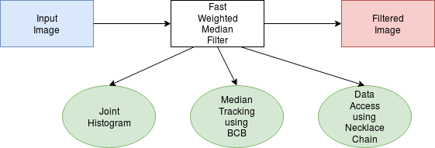
Overview

Slide 8
Joint Histogram
Joint histogram is a two dimensional which stores the pixel count in its bins according to the corresponding features
Each row of histogram corresponds to feature index and each column corresponds to intensity value of the pixel.

Slide 9
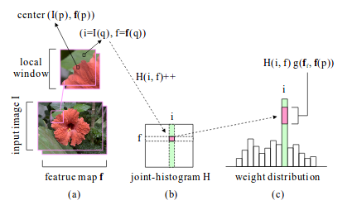
Diagram

Slide 10
Algorithms
Median Finding
Shift and Update

Slide 11
Median Tracking
Median tracking basically exploits the property that almost all images have similar features in the adjacent median finding windows to iterate over joint-histogram in a much efficient way. Median tracking work on concept of Cut point and balance.

Slide 12
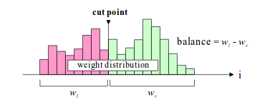
Cut Point and Balance
Tracking Median
Efficient calculation of Balance

Slide 13
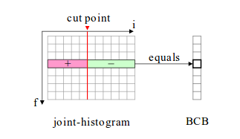
Balance Counting Box

Slide 14


Balance Counting Box
Balance Counting Box stores difference of pixels on both side cut points
So balance can be calculate simply as
Where g is weight map

Slide 15
Necklace Table
Exploit the data sparsity in joint histogram and BCB and reduces the required space as well as time required to access a particular value.
Features
O(1) data access
O(1) element insertion
O(1) element deletion
O(N) traversal

Slide 16
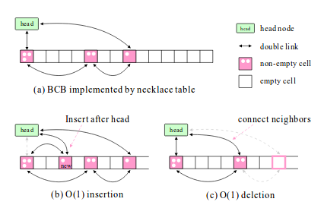
Insertion/Deletion

Slide 17
Results Obtained

Slide 18
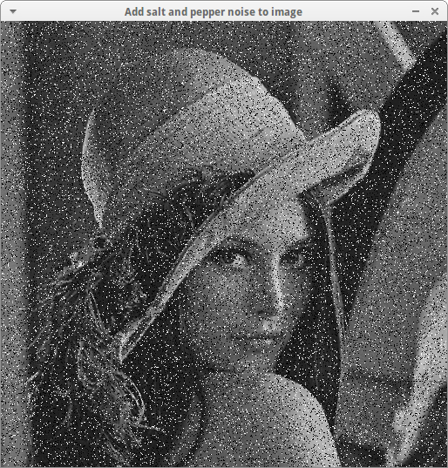
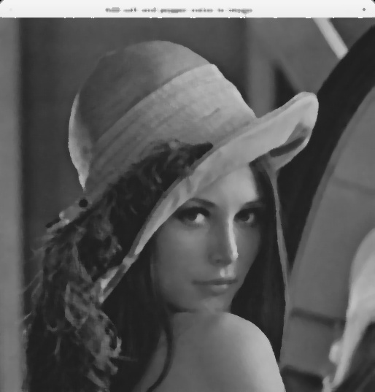
Salt and Pepper denoising

Slide 19
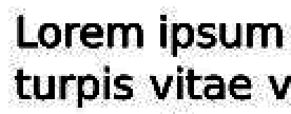


JPEG artifacts removal
Gaussian Filter with radius = 5
Gaussian Filter with radius = 25
Notes:
Gaussian Filter with radius = 5

Slide 20
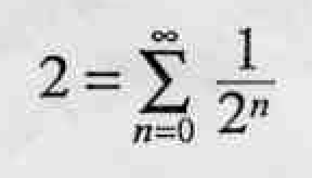
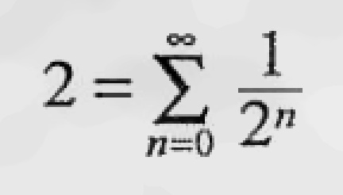
JPEG artifacts removal
Gaussian Filter with radius = 25
Notes:
Gaussian Filter with radius = 5

Slide 21
Experiments

Slide 22
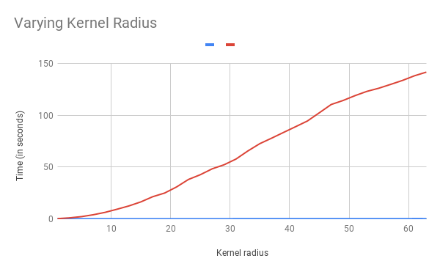

Slide 23
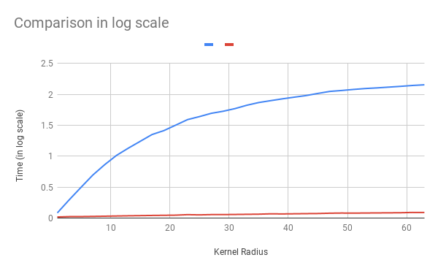

Slide 24
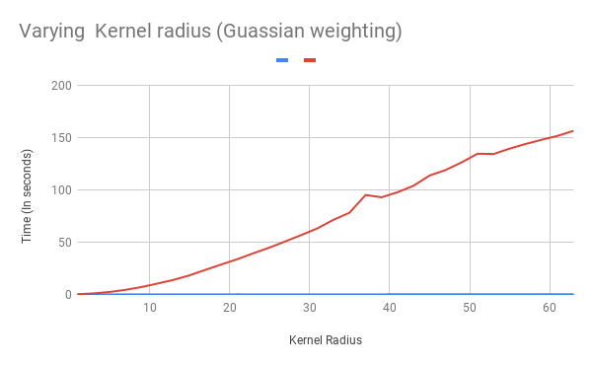

Slide 25
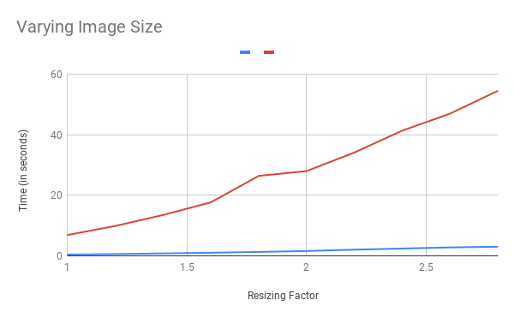

Slide 26
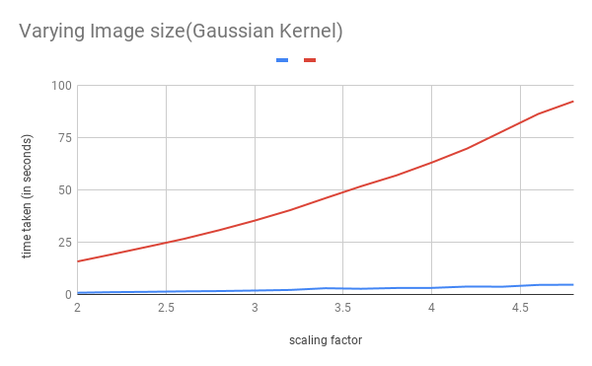

Slide 27
Thanks :)

